Slide 1
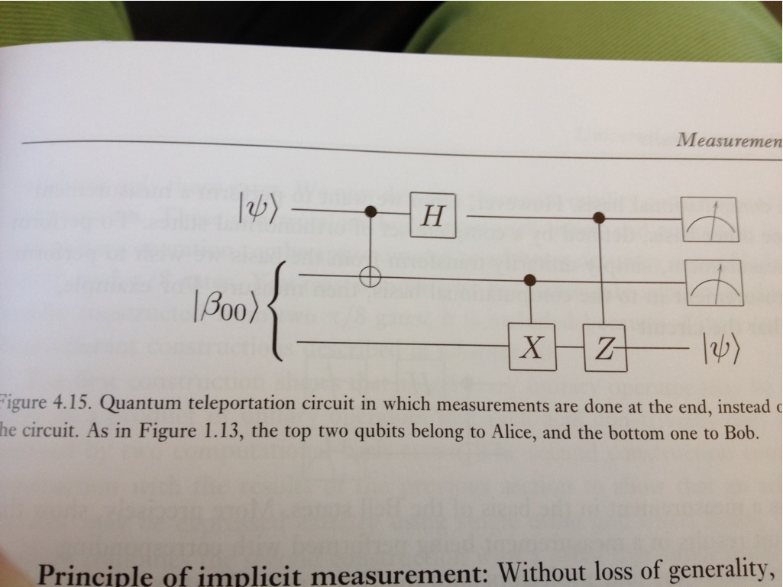
Quantum Lecture 6.9 Teleportation

Slide 2
Agenda for Lecture 6.9
8:30 – 9:00 RECAP of Tensor products &
Video 6.1 No Cloning Theorem
9:15 – 10:00 Video 6.2 Bell-State
10:15 – 11:00 Quantum Computing of TensP.
11:00 – 11:45 Video 6.3 Teleport. 1+ Q.C.TP
11:45 – 12:30 Lunch
12:30 – 13:15 Video 6.4 Teleportation 2
13:30 – 14:00 Exam questions & Multiplechoi.

Slide 3
8:30 – 9:00 RECAP
Your Report of Your Own choice Status
Tensor product
Little No Cloning video
Your Qiskit Teleport. from former lecture ?
During the Gates video remember how You can combine gates ?
Round-up missing something ? Questions ?

Slide 4
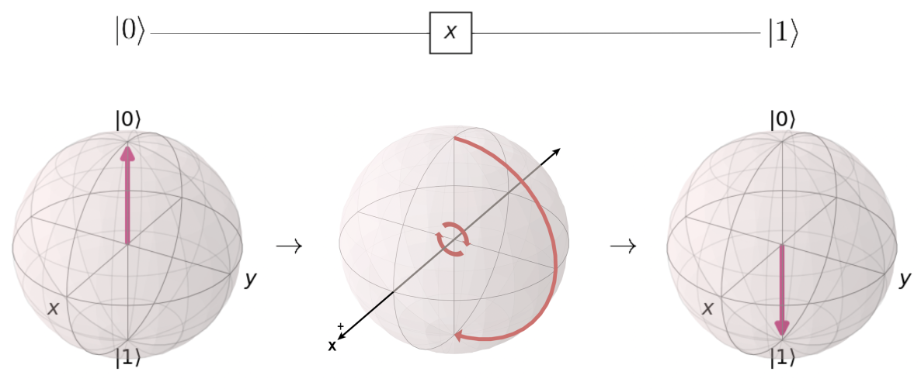
Exercise recaps
What is measurement about
What does the X,Y and Z do as OPERATORS

Slide 5
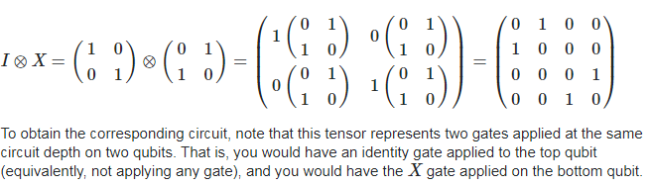
Matrix Con’t
If you are familiar with tensor products, observe that I⊗XI⊗X gives the desired matrix. Showing the steps of this computation,

Slide 6
9:15 – 10:00 Video 4 Bell-States
The Main topic of today is clearly to understand the meaning and power of Teleportation. This implies that You need to know about Bell States , the X,Z and H gates and Measurement
The Bell states describes the 4 different quantum mechanical entangled states of two Qubits
You already know that Entangled qubits can be placed far apart each other !
But how could we possibly do this ????
By TELEPORATION

Slide 7
10:15 – 11:00 Quantum Computing

Slide 8
Exercise in Tensor product cont’d A⊗B
Evaluate or find a qiskit sample that makes a Tensor product of two Pauli gates and shows the result.
Then Try to decompose above to get to the place where You started with two gates
Start with I⊗X
Then Z⊗X, Y⊗X , H⊗X and H⊗CNOT
Try to decompose an entangled state of a Hadamard and CNOT gate like , H⊗CNOT
What happens or maybe Shit happens !!

Slide 9
11:15 – 11:45 Teleportation 1
The Video 1
The Teleportation Qiskit sample – show us !
Check the next slide as a sample dfor hand-debugging

Slide 10
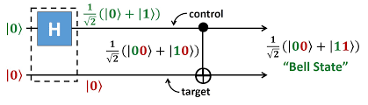
A grahical presentation by Quantum circuits
Show a grahical presentation on how a entangled state will be by a Hadamard and a CNOT gate.

Slide 11
11:45 – 12:30 Lunch &/or Free for the rest of the day

Slide 12
12:30 – 13:15 Teleportation 1
The Video 1
The Teleportation Qiskit sample – show us !

Slide 13
13:30 – 14: Exam + Mult
Exam q
Multi Q
Round up
Something should be ccahnged

